Slide 1






UNICORN COMPANIES
Data Science Lab - 1
Instructure - :
Dr. Dootika Vats

Slide 2

Why is this Project?
About the data
Challenges Faced
Interesting Questions
R Shiny App
Conclusion
References
Presentation Main Points

Slide 3

Why did we choose this project?
We chose this project to find the answers to the following questions:
What is the correlation between GDP and the presence of unicorns in a region?
How many unicorns have women as founders or co-founders?
From which country does the largest number of unicorns originate?
Is there a relationship between a Country's growth rate and startup success?
During which specific years did the majority of unicorns enter the market?
How has the COVID-19 pandemic impacted the growth and trajectory of unicorns?

Slide 4

About The Data

Slide 5


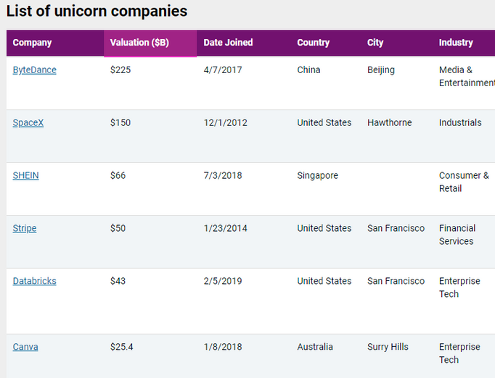
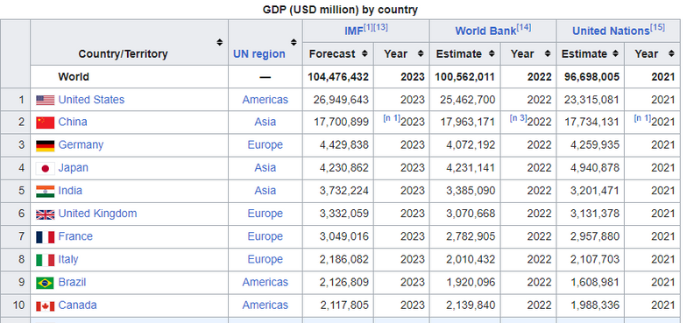
Source of The Data - :
Which provides the complete list of unicorn companies
Which provides the List of countries by GDP (nominal)

Slide 6
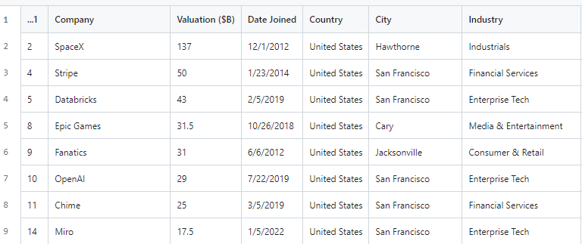
Extracting the Data -:
USING R LIBRARIES RVEST AND TIDYVERSE
USED HTML_TABLE TO EXTRACT TABLES
CLEANED AND FORMATTED THE DATA USING DPLYR

Slide 7
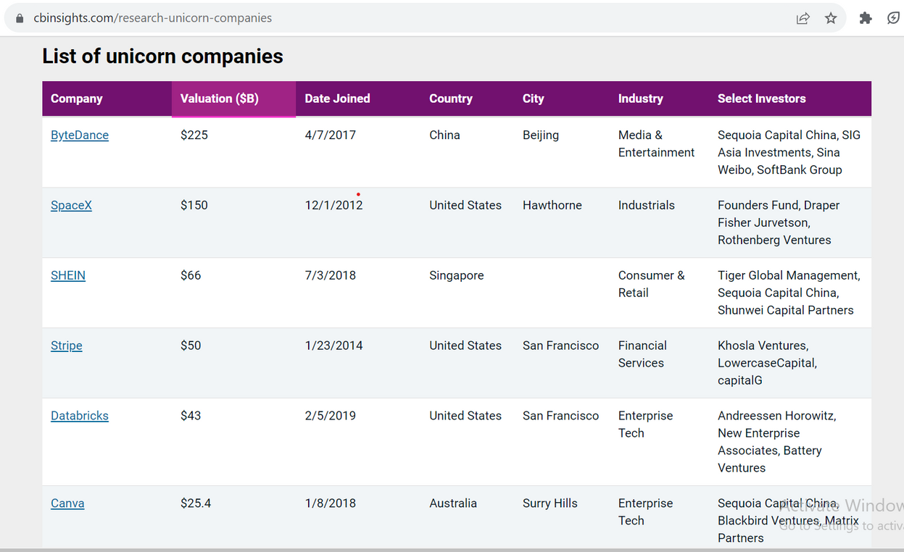
Challenges Faced -:
Solution -
During the extraction of data
1) Founding years data of the Unicorn Startups was not easily available
Scrape data from individually for each country.
2)In extracting the data related to the startups which had a female head. The data was not available in a tabular format.
So we had to scrap the data from the text available on the website.
3) The data extracted from the website through the text had multiple missing values. Since we extracted them in string format it was challenging to remove them and then convert the data into a dataframe.
We found a pattern in the data we extracted and leveraged that to construct a data frame after cleverly manipulating the data to get rid of the missing values.

Slide 8

Interesting Questions
&
Related Plots

Slide 9
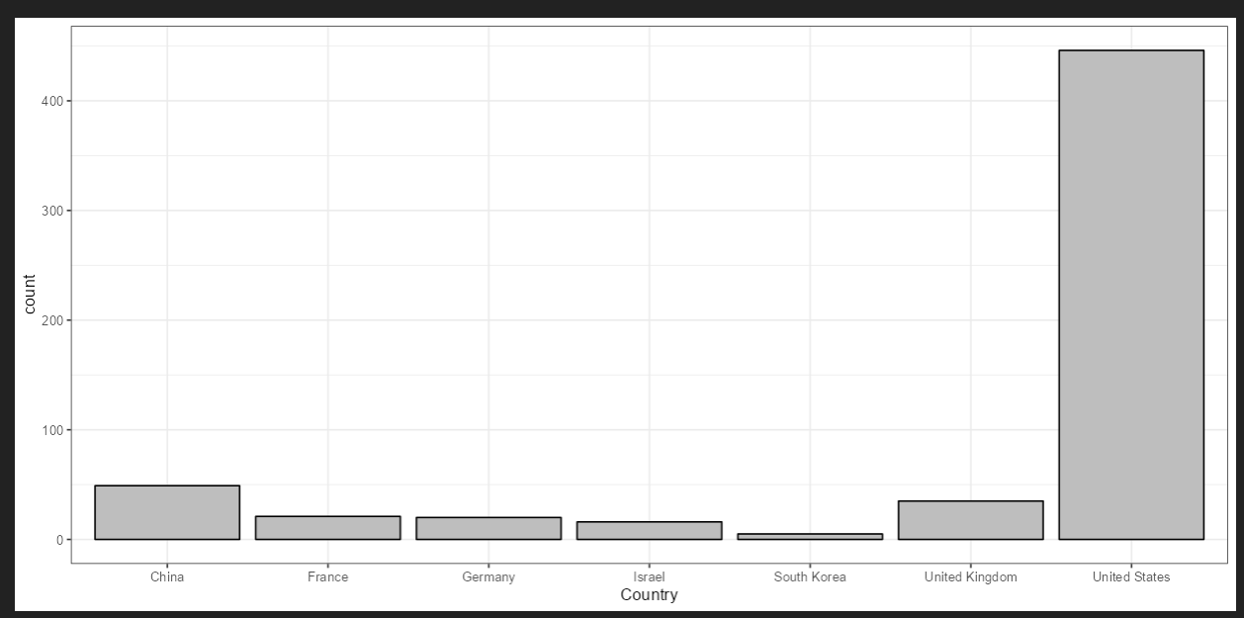
From which country does the most number of unicorns originate?
The United States has the most unicorns.
China is in second place.
Number of unicorns vs Countries

Slide 10


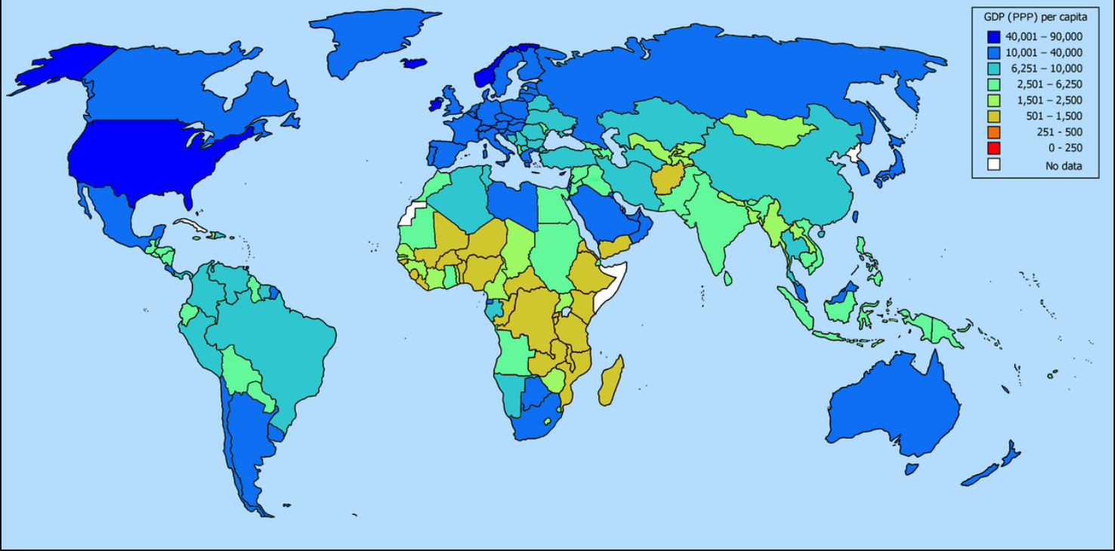
What is the relation between GDP and the presence of unicorns in a region?
There is Positive correlation between GDP and the presence of unicorns in a region
Unicorns mostly emerge from developed countries with India and China being an exception.

Slide 11
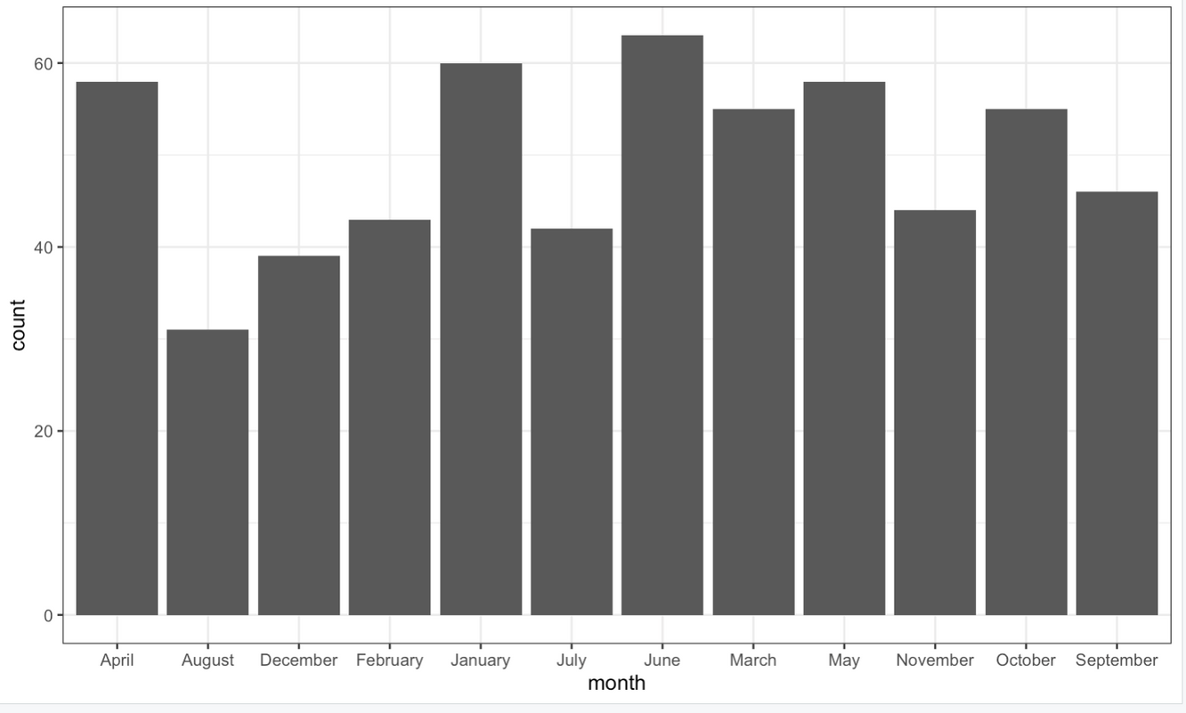
When do most unicorns emerge?
Unicorns usually emerge at the beginning of the fiscal quarter: January, April, and October except in the third quarter where most of them emerge at the end of the quarter.
Most unicorns also emerged during the second quarter: April, May, June.

Slide 12
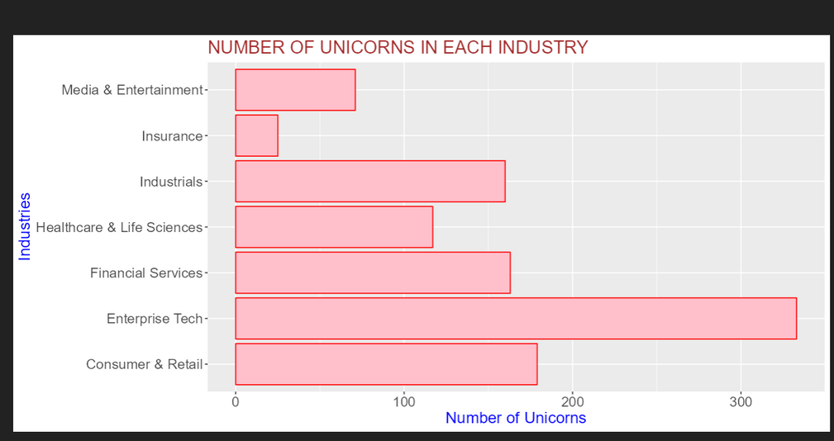
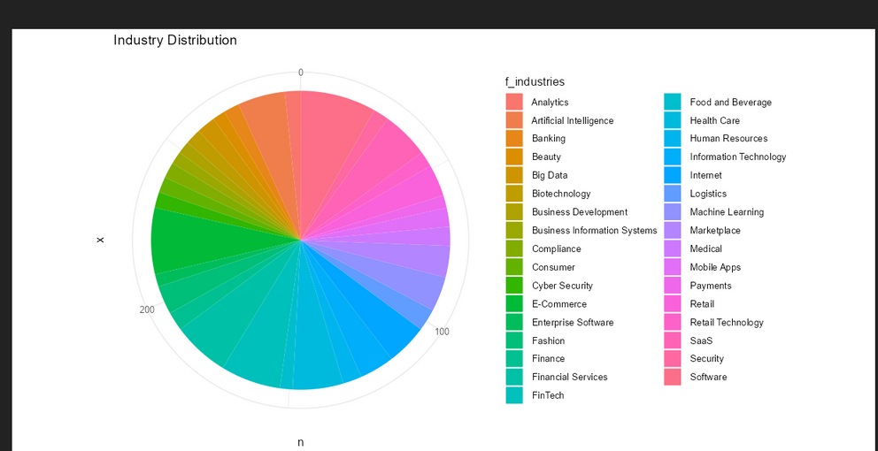
Number of unicorns in each industry & Valuation for each industry with years

Slide 13

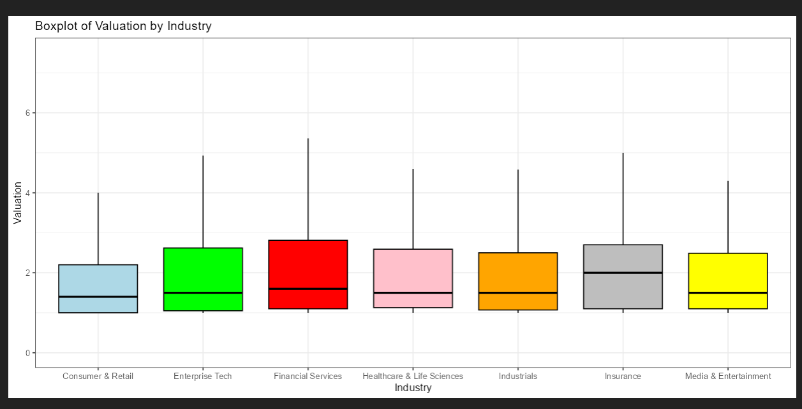
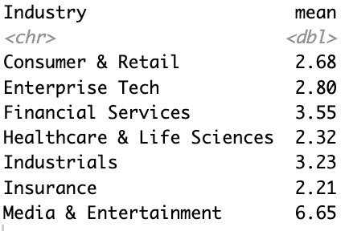
Valuation vs industry boxplot
Valuation in Billions

Slide 14
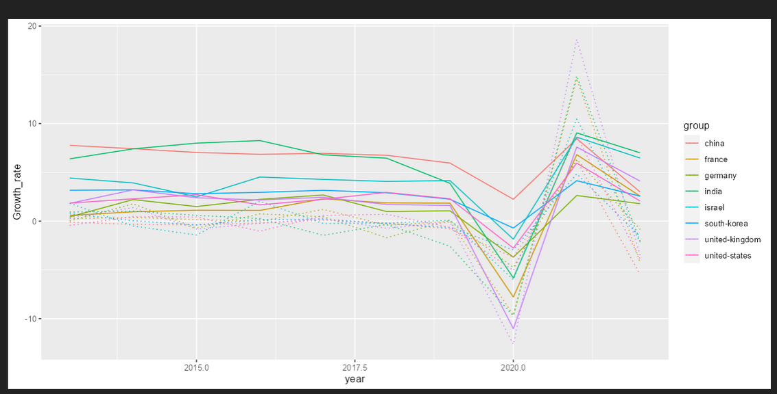
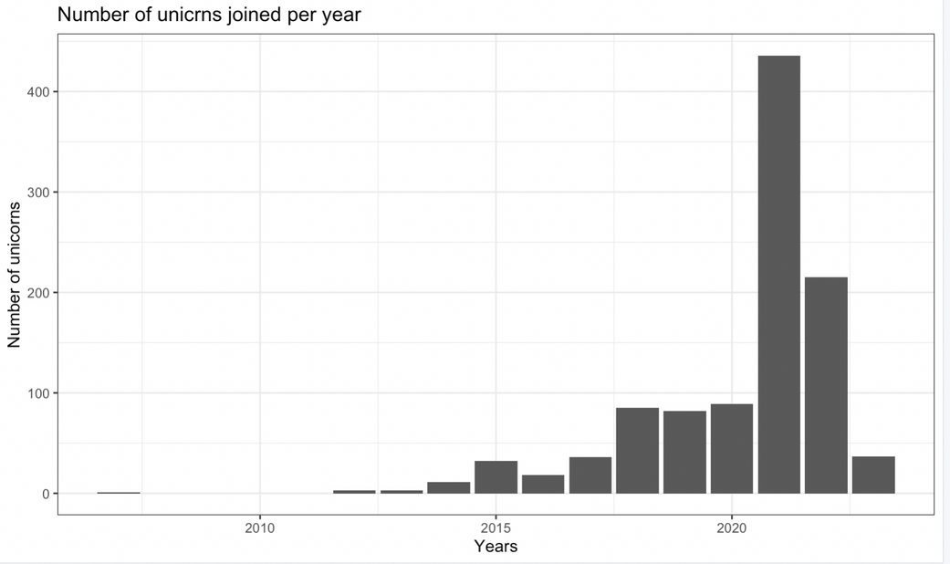
Yearly Growth rate for each Country.
We observed that the growth rate in the pre-covid period has been fairly uniform but there isn’t that much impact of growth rate on the unicorns emerging however the growth rate being negative in 2019-2021, most unicorns have emerged during that period.
(This was the Covid Period)
Apparently being jobless at home is good for the Unicorns :)

Slide 15
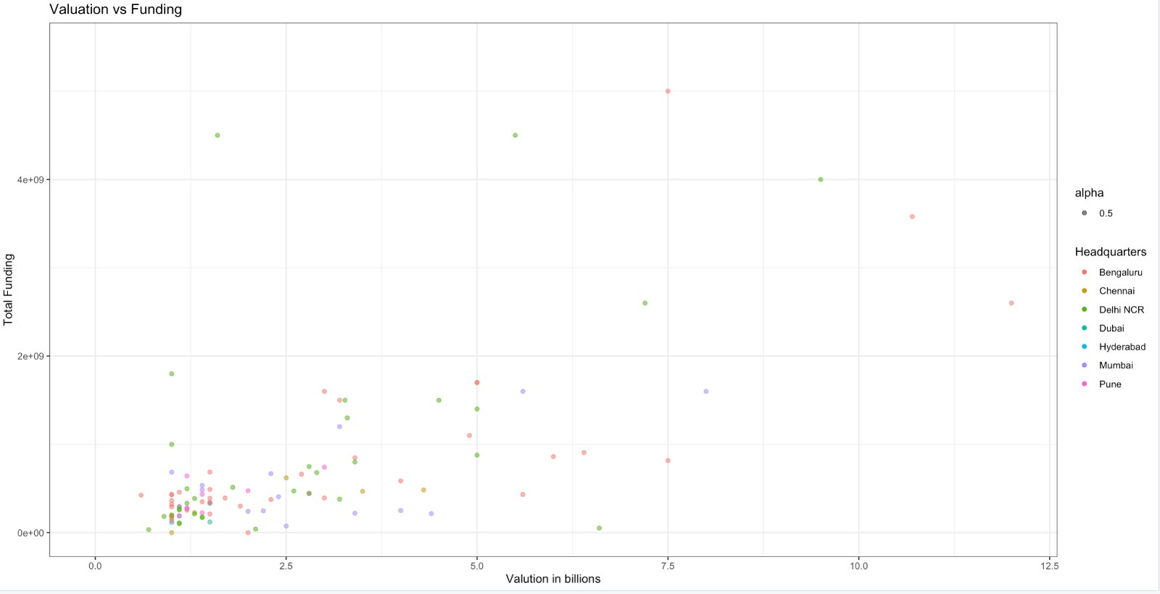
Analysis of unicorns in India

Slide 16
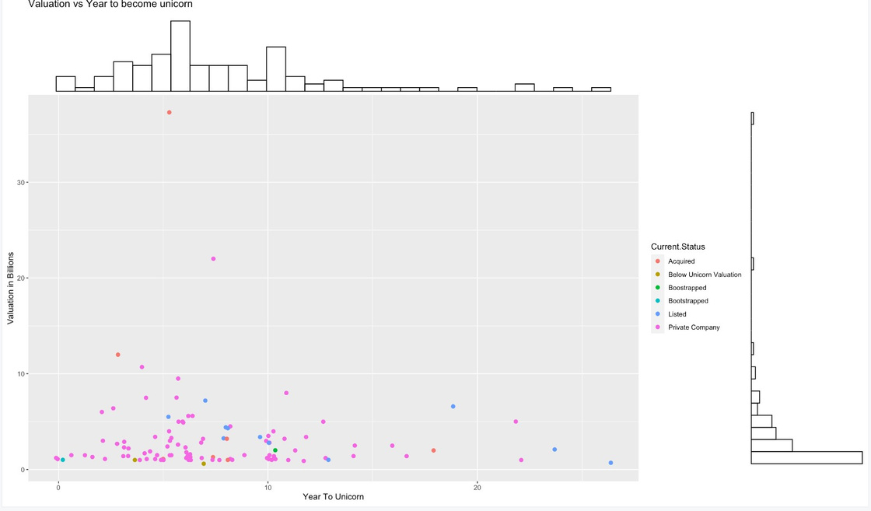
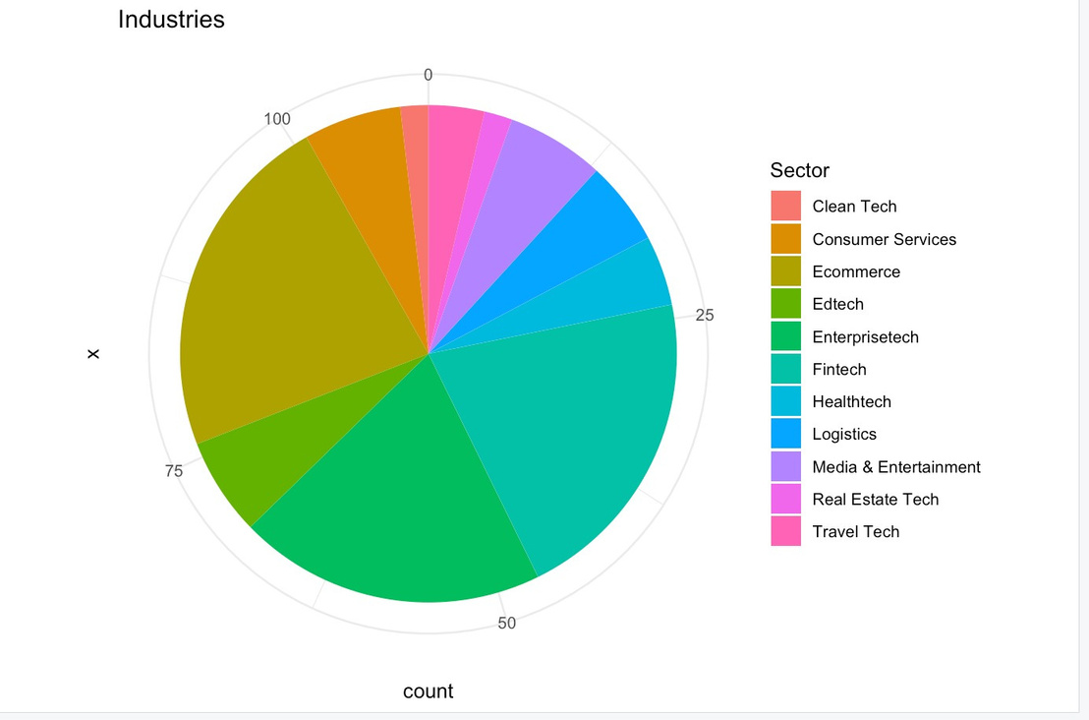

Slide 17

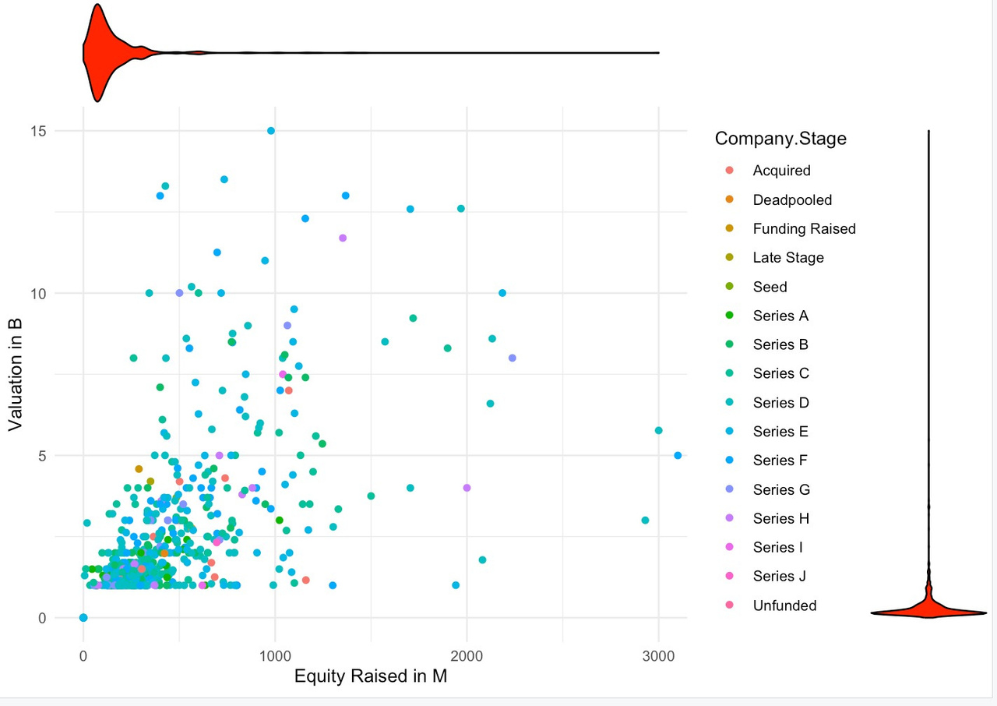
Scatterplot of Valuation Vs Equity raised with colour denoting company stage
Most Companies have raised equity below 500 million and their is lesser than 3 billion.

Slide 18
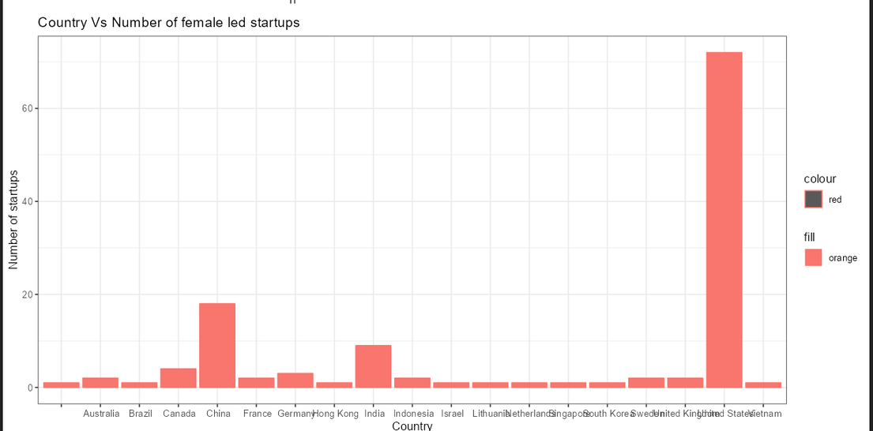
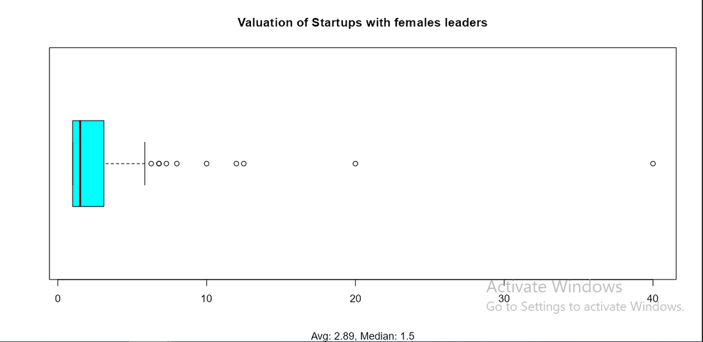
No. of female founded Startup Vs Countries.
Box plot of valuation of the Startups

Slide 19






R Shiny App

Slide 20


Slide 21

Conclusion :-
Most unicorns emerge from the US and China.
There’s a positive correlation between the GDP of a country and the number of unicorns.
Max number of unicorns emerge from the Enterprise Tech industry.
The Industries with the most valuation are Media & Entertainment and Financial Services.
Unicorns emerged during the COVID period despite the economy of the country being down.
A similar distribution is seen in the number of female-led startups as the rest with the country of origin.

Slide 22


This Presentation is prepared by
Group 21

Slide 23


References -:
CB Insights
https://www.cbinsights.com/research-unicorn-companies
Wikipedia
https://en.m.wikipedia.org/wiki/List_of_countries_by_GDP_(nominal)
Insider
https://insider.finology.in/business/indian-unicorns-losing
https://golden.com/query/list-of-founders-of-unicorn-companies-GNEZ

